Slide 1
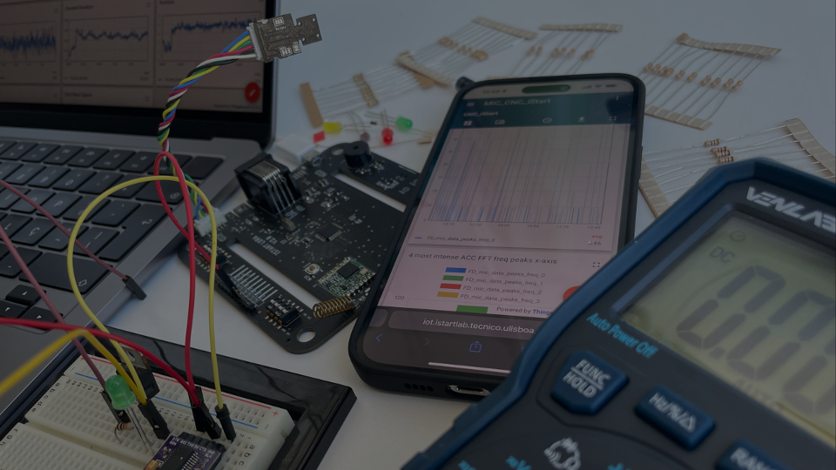

Vital Monitorization Bracelet
ElectroCap Mid-Program Pitch Deck
Pedro Lopes nº 103194
Vasco Martins nº 103196
Tiago Dias nº 103238
Miguel Pereira nº 103254
António Quendera nº 103321
Bernardo Santos nº 103570

Slide 2
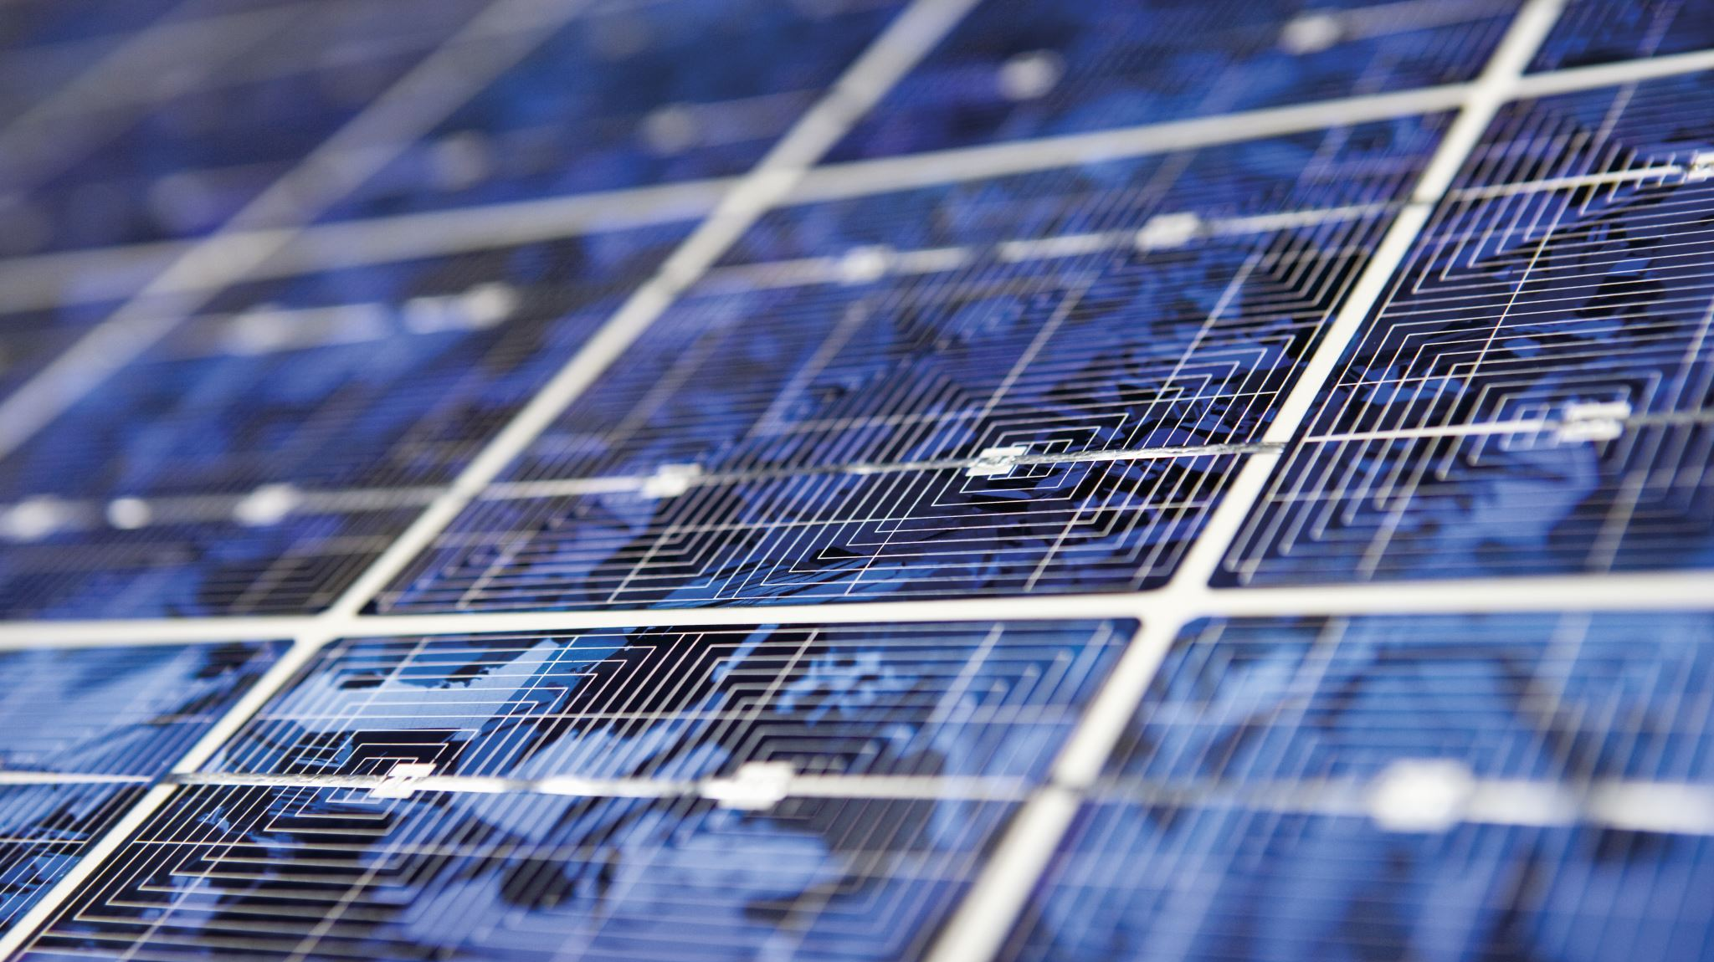
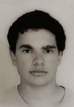
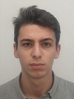
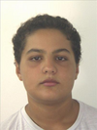
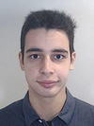
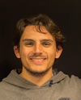
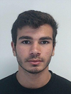
Our Team
Pedro Lopes
Team Member 1
Vasco Martins
Team Member 2
Tiago Dias
Team Member 3
Miguel Pereira
Team Member 4
António Quendera
Team Member 5
Bernardo Santos
Team Member 6

Slide 3


Advisors and Mentors
Scientific Advisor
Scientific Co-Advisor
Teresa Vazão
Ricardo Santos

Slide 4

Problem definition
In Portugal, more than 44.100 elderly people live in isolation.
This number is likely to grow.
It’s hard to assure the safety of these people.

Slide 5

Solution beneficiaries
We are trying to reach out to:
Individuals with family members in these conditions.
Institutions and professionals whose job involves assuring the safety of old people.
The elders themselves.

Slide 6

Technological solution
Acquire data from a gyroscope, accelerometer, cardiac rate sensor, and oximeter.
Translate data to useful information (motion tracking, heartbeat) in a cloud-based server.
Display the relevant information in a phone application.
Easy to check the condition of an elder and via notifications, it’s possible to act faster in case of an emergency.

Slide 7
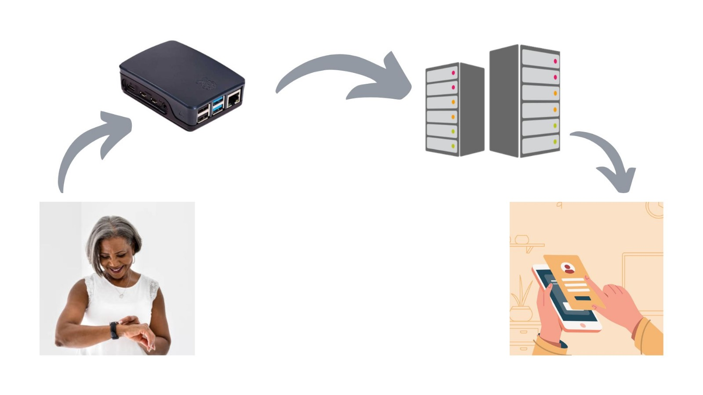
Solution Visualization
The bracelet gathers information constantly
It transmits it to a local router
The rooter sends the information to the server
Finally the server communicates the information to the app

Slide 8


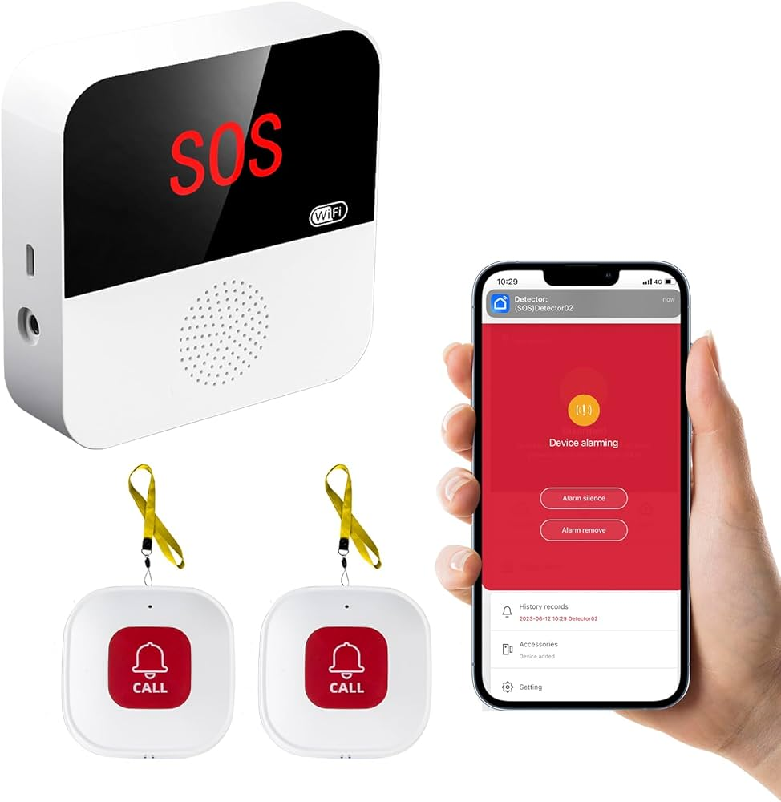
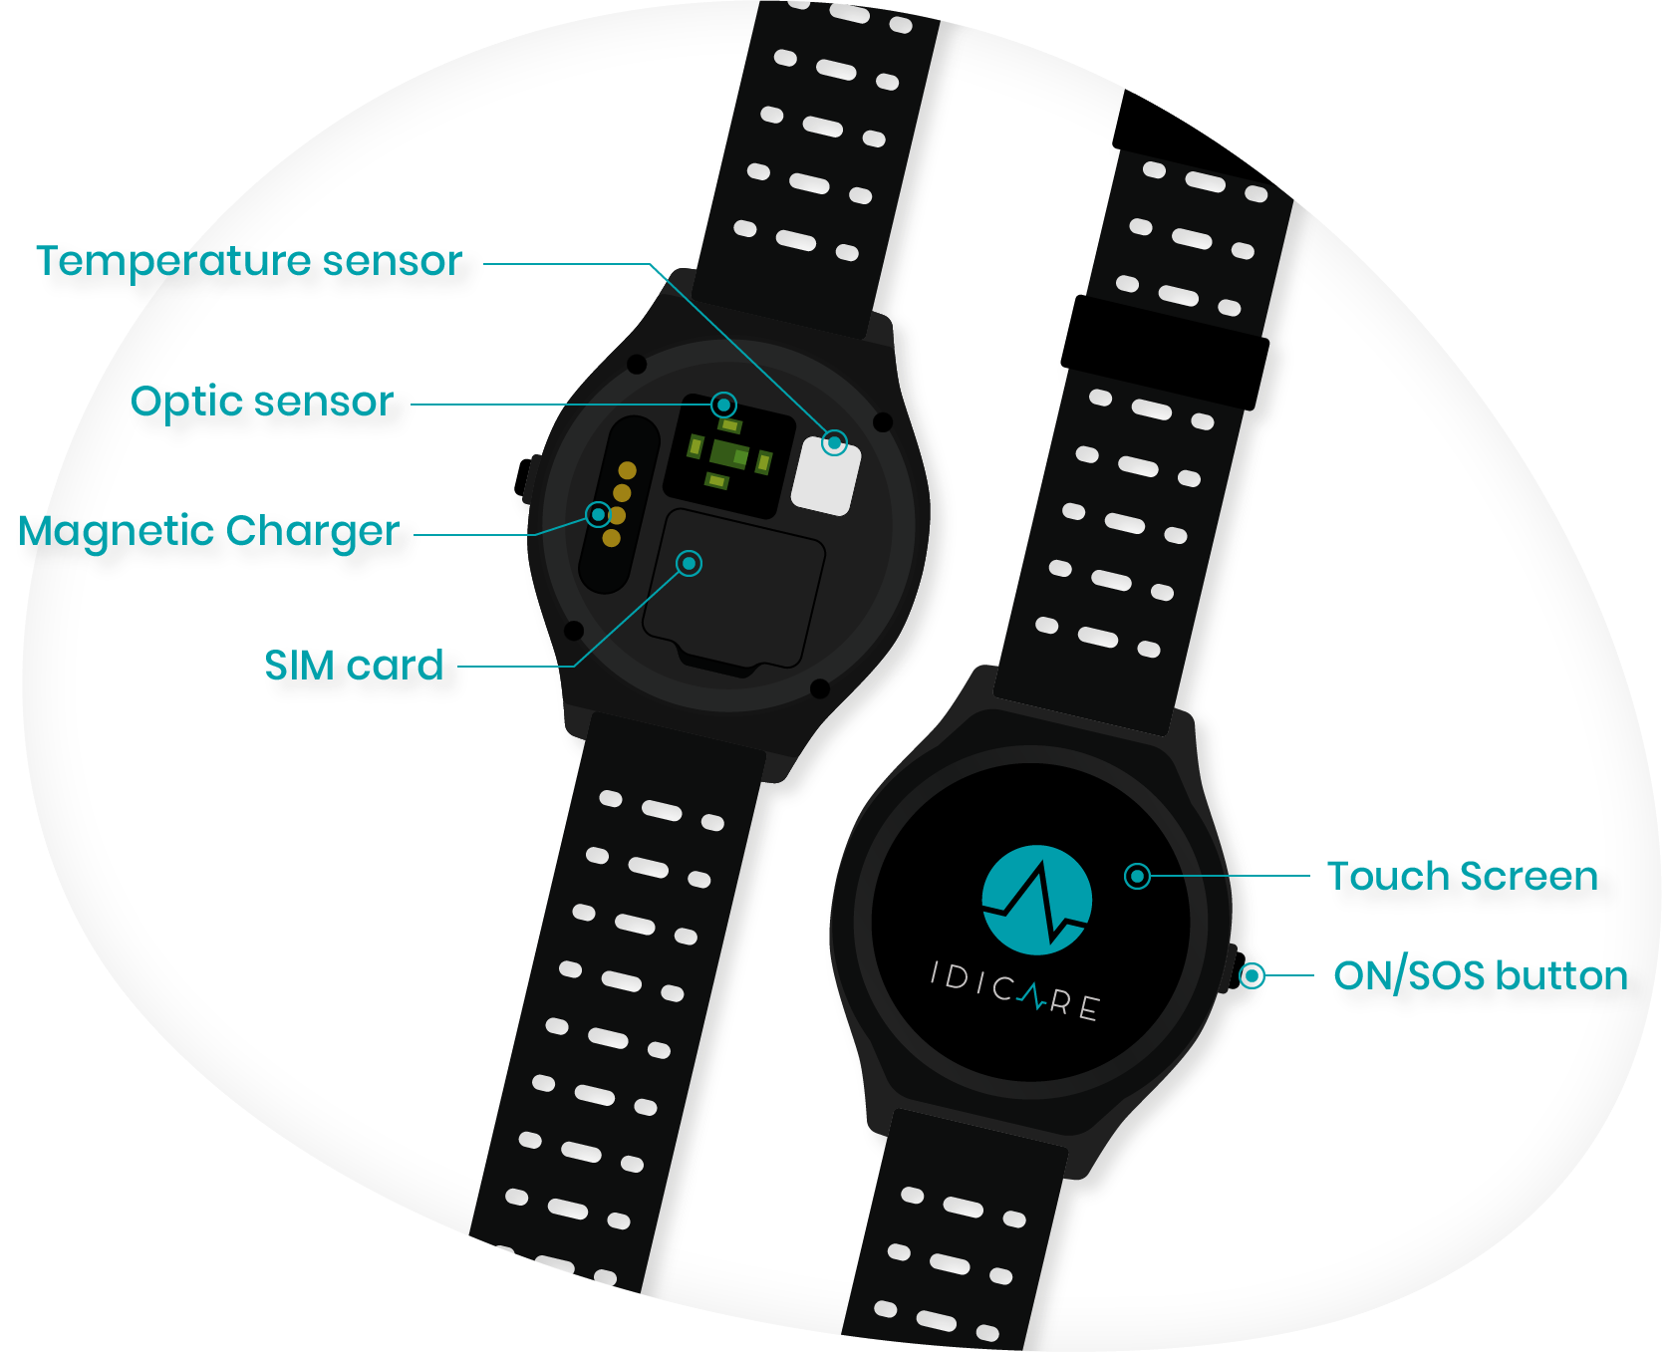
Competitors
IDIWATCH (https://idicare.com/pt/idiwatch/ ) – out of service.
Pager – only works as SOS.
Caring professionals – requires the presence of a person 24/7 to have full-time monitorization.

Slide 9
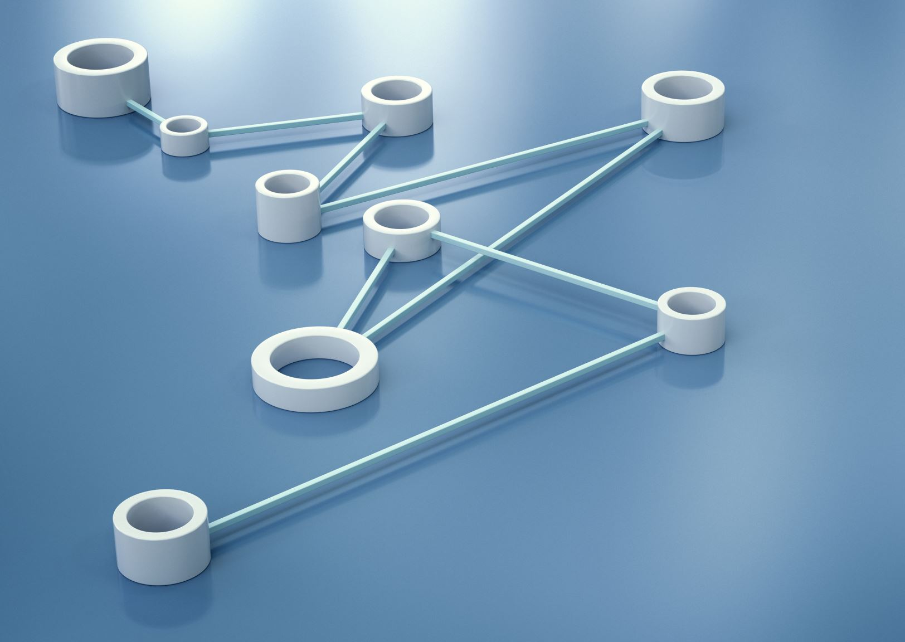
Solution requirements
Comfortable and robust bracelet.
Lasting battery of reduced size.
Reliable data acquisition.
Private and secure connection with the server.
Intuitive application.

Slide 10

Technical challenges
In the project's implementation, we anticipate that the most challenging aspect will be ensuring that the bracelet is practical, comfortable, and water-resistant since the goal is for it to be worn for extended periods, including during bathing.
Ensuring the longevity of the battery life will also be a challenge. Providing an intuitive interface for both the user and the monitor is another important aspect.
Implementing a robust and fast communication system that allows the monitor to receive alerts with minimal latency will also be a significant challenge.

Slide 11

Partners
Currently operating independently.
Professional caretaker (potential partner).
Juntas de freguesia.
Nonprofitable organizations.

Slide 12

Testing and validation metrics
Extensive sensor testing in a controlled environment.
Autonomy tests.
Server stress testing.
Prototype testing in a controlled environment.
Prototype testing with elderly people.

Slide 13
Initial division of labor (1)
Pedro Lopes | Vasco Martins | Tiago Dias
Data Treatment | Hardware Setup | System Modulation
Data Translation | Router Setup | Design Data Base
Server/client Protocol Setup | Final Prototype Setup | Pattern Identification
Algorithms Definition | Find partners and volunteers for testing | Battery Solution

Slide 14
Initial division of labor (2)
Miguel Pereira | António Quendera | Bernardo Santos
Communication Network | App Interface | Eletronics
Protocol Definition | App Design | Sensors and Processor Setup
Server/client Communication | App Implementation | Sensor Calibration
Site Development |  | Sensor Testing

Slide 15
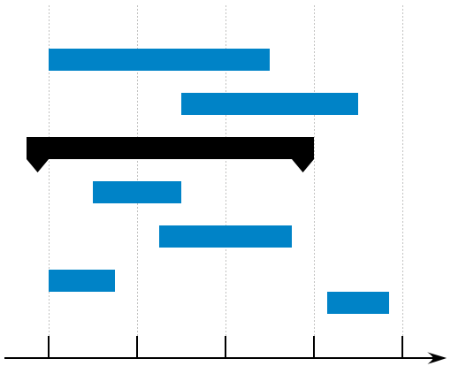
Original Schedule
May
March
April
February
Electronics
Data treatment
Communication Networks
App Interface
Communication and divulgation
Prototype Design
Data treatment
Communication Networks
App Interface
Electronics and Prototype Design
Data treatment
Communication Networks
App Interface
Proof of concept testing (sensors and antenna)
Data colecting
Protocol definition
Bracelet modulation
Data colecting
Padron identification
Router Development
Data View
Prototype assembly
Communication tests
Interface design
Testing in real situations
June
Demo Day
Algorithms Definition
Sketch
Site set-up
Eletronics
Sensor calibration and testing
Prototype Design
Charging method optimization

Slide 16

Mid-program status
A low-level prototype of the application has been made;
More than half a dozen interviews were conducted with elderly individuals or their respective family members;
Tests were carried out to assess the functionalities of the heartbeat sensor, gyroscope and accelerometer sensors;
Google Forms designed to enquire elderly or family members;
Website updated and well-structured with what has been accomplished so far;
Unfortunately, the choice of processor is pending due to complications with sensor’s compatibility.

Slide 17

Achieved results and new objectives defined
Results and Conclusions so far:
Limit the project to household use only;
Guarantee the safety of user data used to ensure users' satisfaction and trust;
The HR sensor needs precise placing to ensure good results;
Use of Arduino for bracelet main processor;
App design to use simplistic and simplified health markers as default.
New Objectives:
System with in-house router (Raspberry Pi) connected to the internet;
Required minimal prototype that is functional, discrete and comfortable required for testing.

Slide 18
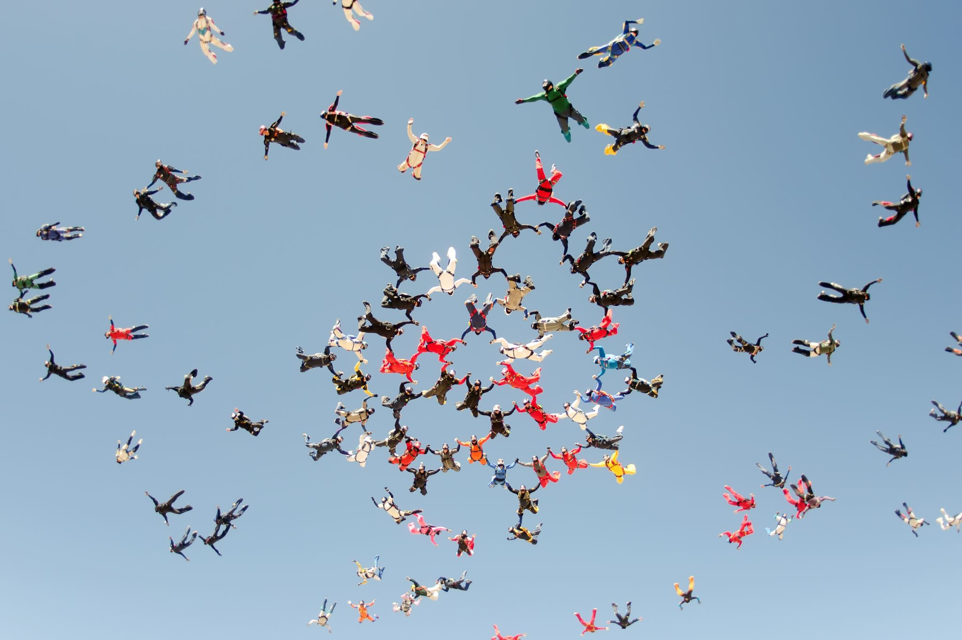
Challenges faced by the team
Battery: We had to balance the functionalities we planned to implement, to ensure the energy efficiency of the bracelet;
Usage Environment: We opted to implement the use of the bracelet in a domestic environment due to the lack of viable means of communication without an external device to the bracelet when outside the home;
Size: We faced difficulties in choosing the microprocessor and the sensors, to ensure that the bracelet did not become too large on the wrist.

Slide 19

Deviations from original schedule
Main causes:
Yet to start data treatment due to time delay in the sensors acquisition;
We didn't have as much time as we expected due to heavy work on other courses.
Consequences:
Although we experienced some alterations, the calendar didn't suffer many modifications;
We may be left without enough time dedicated to optimization testing.

Slide 20
Contribution of each team member (1)
Pedro Lopes | Vasco Martins | Tiago Dias
Server solution | Sensor set up | Interviews
Research solution with remote server | Sensor choosing | Write interview guide
Integration processor-sensor | Sensor testing | Interviews
Interviews |  | Research I2C

Slide 21
Contribution of each team member (2)
Miguel Pereira | António Quendera | Bernardo Santos
Site set up | App design | Processor set up
Site set up | Low level prototype | Processor choosing
Research solution with personal server | Research graphic design | Processor testing
Site update | Design app home page
Team managing | Interviews

Slide 22
Corrected Schedule
May
March
April
February
Electronics
Communication Network
App Interface
Communication and divulgation
Electronics
App Interface
Comunication and divulgation
Electronics
Data treatment
Communication Network
App Interface
Communication and divulgation
Arduino selection
Protocol definition
Site set-up
Testing with sensors
Market Interface Research
Forms
Gathering information of multiple tests/situations
Raspberry Pie tests
Main screen design
Gathering Google Forms responses
June
Demo Day
Low level prototype
Prototype Design
Initial Model Conceptualization
Prototype Design
Charging method optimization
site is operational
Get all the sensors to work with the arduino
Study of the sensors feedback
Pattern Identification
Testing in real situations
Final adjustments
Data Treatment
Final algorithms definition
Communication and divulgation
Photo and vídeo recording
Secondary screens sketches
Translate the obtained info
Communication server/client tests
Communication Network
Implementation of the final router
Debug communication flaws
Website completion
Eletronics
Final hardware setup
App Interface
All screens finished
Implementing the final app via code
Search for partners
Start app development

